Slide 1
Chittagong University of Engineering & Technology Department of Computer Science & Engineering
Basic Deep Learning Concepts

Slide 2
Contents
Understanding CNN architecture
Understanding Layers of CNN
What Activation functions and its types
Weight Initialization types
Details about Optimization Algorithms
Forward and backward Propagation
Understanding Regularization Techniques
Use case of CNN
Model Evaluation Metrics

Slide 3
Objectives
To give ideas about CNN architecture
To give ideas about all of the layers of CNN
To provide details on Activation functions
To provide details on Optimization Algorithms
To provide an description regularization Techniques.
To give ideas about Back propagation , Forward Propagation
To provide ideas about Image preprocessing
To provide ideas about different evaluation metrics.

Slide 4
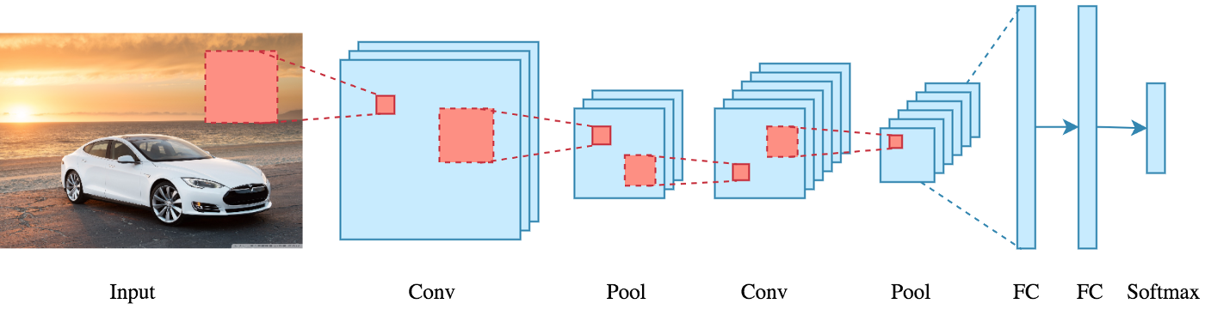
Basic Architecture
A series convolution + pooling operations, followed by a number of fully connected layers.
For multiclass classification the output is softmax.

Slide 5

A Typical CNN
A classic CNN architecture would look something like this:
Input ->Convolution ->ReLU ->Convolution ->ReLU ->Pooling ->ReLU ->Convolution ->ReLU ->Pooling ->Fully Connected

Slide 6
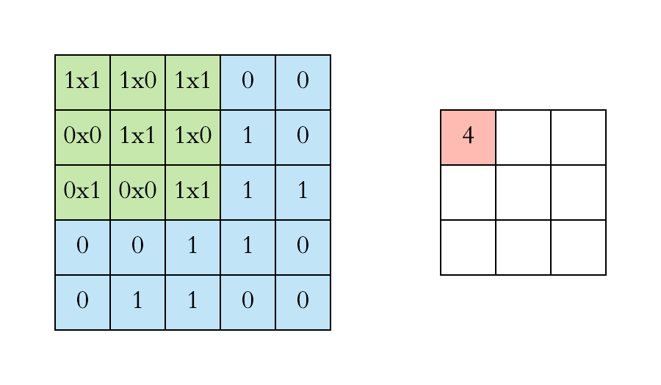
Convolution
A mathematical operation to merge two sets of information.
In CNN, the convolution is applied on the input data using a convolution filter.
The fundamental difference between a densely connected layer and a convolution layer is this: Dense layers learn global patterns in their input feature space,whereas convolution layers learn local patterns.
Left side : Convolution layer
Layer(input image)
Right side: Convolution
filter (Kernel)

Slide 7
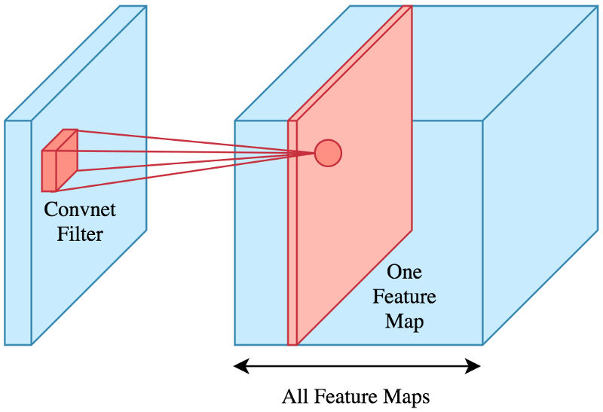
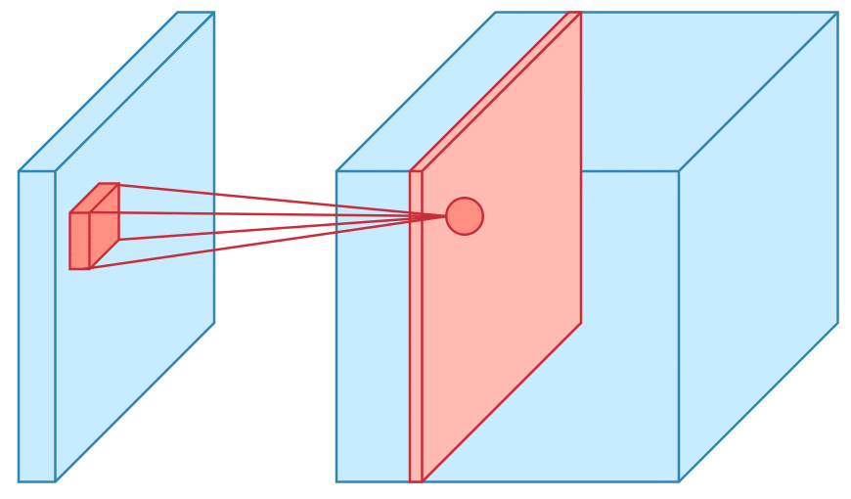
Convolution(Contd..)
In reality an image is represented as a 3D matrix with dimensions of height, width and depth.
The filter is slided over the input like below and perform the convolution at every location aggregating the result in a feature map.

Slide 8
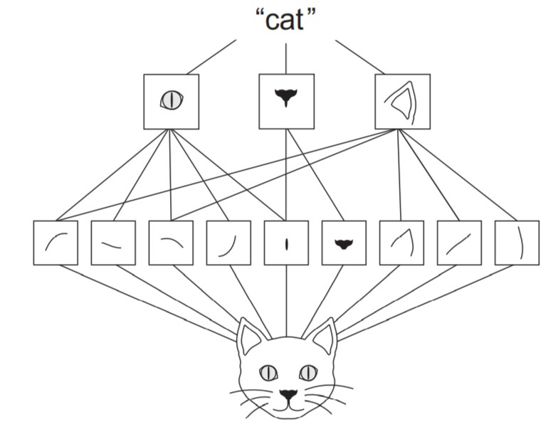
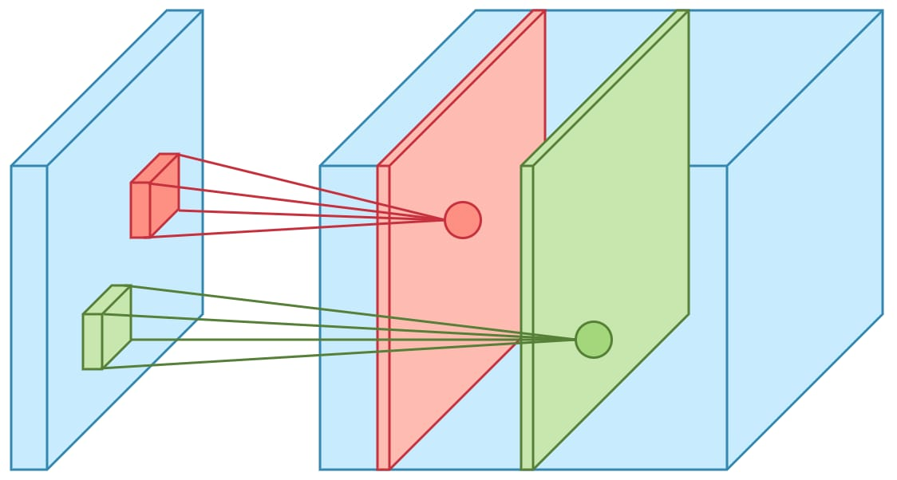
Convolution(Contd..)
Multiple convolutions is performed on an input, each using a different filter and resulting in a distinct feature map.
Then stack all these feature maps together and that becomes the final output of the convolution layer.
Input:10 different filters
& 10 feature maps of size
32*32*1
Output: A volume
of size 32x32x10

Slide 9
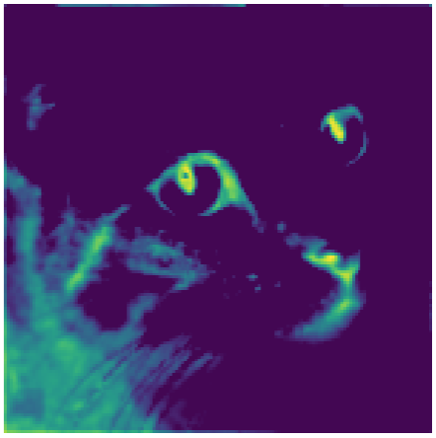
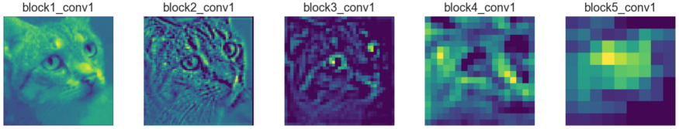
Layered Representation
One of the feature maps from the output of the very first layer (block1_conv1) looks as follows : Bright areas are the “activated” regions, meaning the filter detected the pattern it was looking for.
Observations:
In CNN architectures the first layers usually act as edge detectors.
Deeper feature maps contain less information about the image and more about the class of the image.

Slide 10
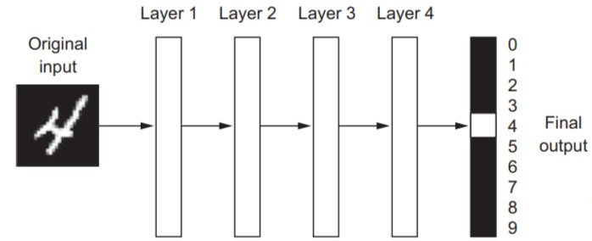
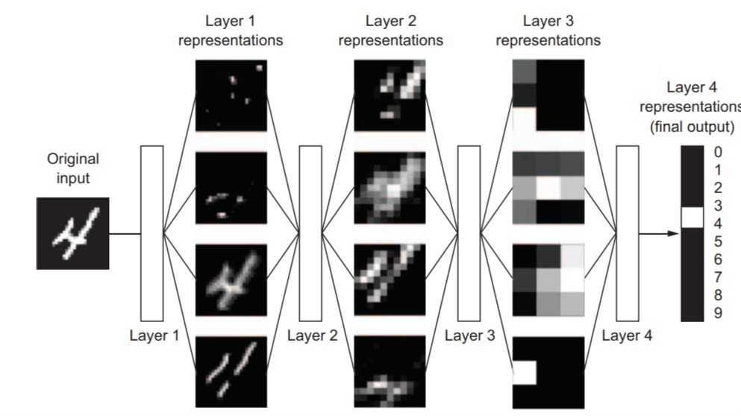
Layered Representation (Contd..)
The deep in deep learning isn’t a reference to any kind of deeper understanding achieved by the approach; rather, it stands for this idea of suc_x0002_cessive layers of representations. How many layers contribute to a model of the data is called the depth of the model.
Deep Learning often involves tens or even hundreds of successive layers of representations

Slide 11
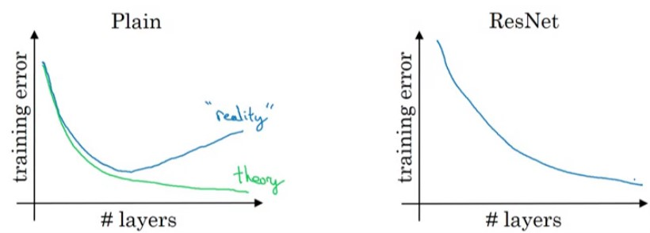
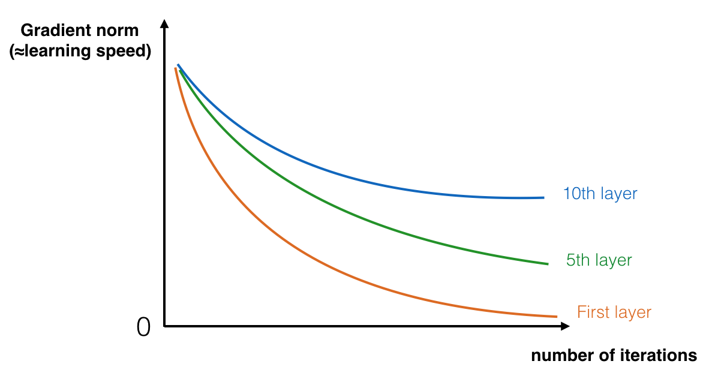
Degradation in Deep Neural Network
As we increase network depth, accuracy gets saturated.
We increased the layers of our network further (after the saturation region), the accuracy of the network dropped.
You can imagine that this difference, this gradient will be even smaller and smaller as we go back layer by layer towards the image itself(backpropagation), due to overall weights smaller than one. This is what we call "vanishing gradient" .
ResNets can be used to avoid such problems.

Slide 12
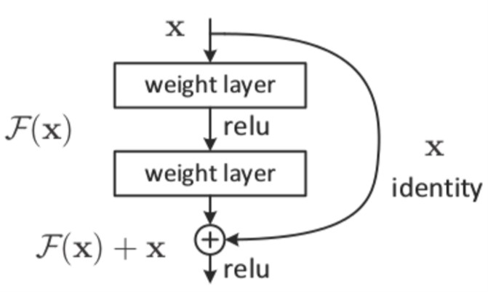
Residual Neural Networks
ResNets are the type of neural network that applies identity mapping. What this means is that the input to some layer is passed directly or as a shortcut to some other layer.
Skip connection is basically the identity mapping where the input from previous layer is added directly to the output of the other layer.
If x is the input and F(x) is the output from the layer, then the output: Y=F(x)+x
Vanishing gradients can be avoided by these
shortcuts. If you make shortcuts even just
over one layer, the gradients can take a
shorter path back, which will be roughly
half of the original length

Slide 13
Filter
Why filter size of odd numbers are preferred ?
We know ,
p = (f-1)/2 where, p = padding size
f = the size of filter
By convention of computer vision filter size is usually odd(3*3,5*5 etc). Reasons are:
1.If f is even then we need asymmetric padding(Pad more on left or right)
2.Odd size filter has a central position , thus we have the central distinguished pixel so that we can find positions of the filter appropriately.

Slide 14
Filter(Contd..)
When to choose small filter and when to choose larger filter?
Filter size is one of hyperparameter we have to choose before training your network.
For small and simple images (e.g. Mnist) you would need 3x3 or 5x5 filters and few of them detect straight lines, curves, obliques , and some color tonality; while for larger images (e.g. faces or landscapes), a bigger receptive field might be needed with 7x7, 9x9 or 11x11 filters.
To eradicate confusion about filter size and pooling layer is the motivation for Inception Network.

Slide 15
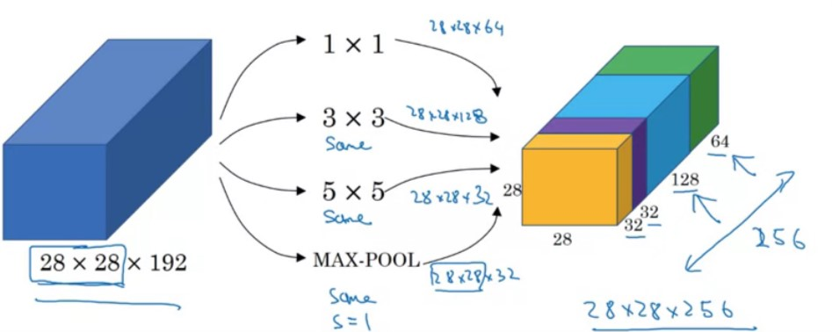
Filter(Contd..)
The basic idea is that instead of you needing to pick one of these filter sizes or pooling you want and committing to that, you can do them all and just concatenate all the outputs, and let the network learn whatever parameters it wants to use, whatever the combinations of these filter sizes it wants.
Using a 1*1 convolution, you can create this bottleneck layer thereby reducing the computational cost significantly.

Slide 16
Filter(Contd..)
How to appropriately choose the number of filters?
The number of filters is a hyper-parameter that can be tuned.
The filter sizes 32, 128, etc. are used because of memory and efficiency. There is nothing holy about these numbers.
The initial layers extract low-level features- they consist of edge detectors, etc. There aren't many such features. So, we won't gain much by adding a lot of filters as Most of them are quite similar/meaningless for our job. Using a lot of filters might even lead to overfitting.
The latter layers are responsible for detecting more features, like elbows/nose shape from the lower level features extracted previously. So, we might do better if we increase the number of filter. Also, note that the resultant layers become more and more sparse as we go deeper.
Though it might differ in applications like super resolution image, in general, the number of filters stays the same or increases when we go deeper.

Slide 17
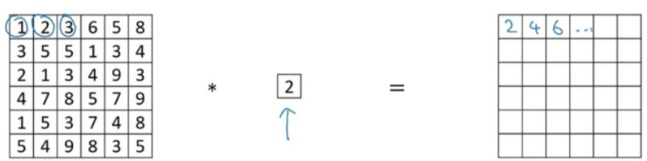
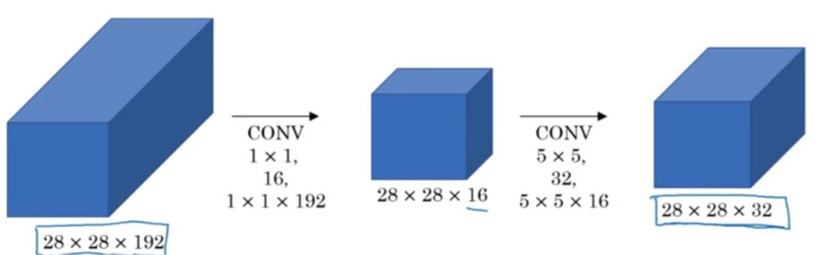
Filter(Contd..)
What is the purpose of 1*1 filter?
It seems like multiply
a matrix by a number.
Shrink the number of
channels and therefore save
on computation in some networks.
It has nonlinearity. It allows you to learn a more complex function of your network by adding another layer.

Slide 18
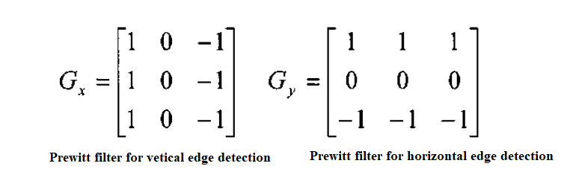
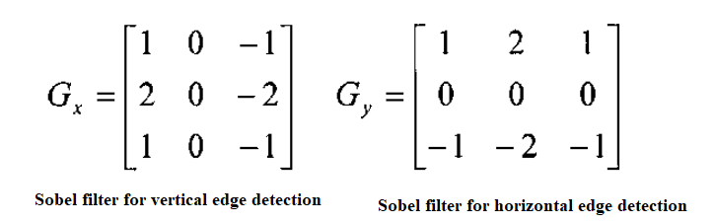
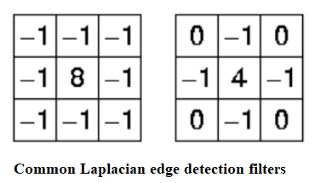
Filter(Contd..)
Filter Metrix Values:
Prewitt Edge Detection:
Most commonly used.
Sobel Edge Detection:
Gives emphasis on the center
of the filter.
Laplacian Edge Detection:
Performs second order derivatives
and sensitive to noise

Slide 19
Filter(Contd..)
How to choose values of filter matrix?
We can Initialize filter value with random 1 and 0 in a matrix. The filter value are learnt during training (i.e. during backpropagation). Hence, the individual values of the filters are often called the weights of a CNN.
And rather than just vertical and horizontal edges, maybe it can learn to detect edges that are at 45 degrees or 70 degrees or 73 degrees or at whatever orientation it chooses. And so by just letting all of these numbers be parameters and learning them automatically from data is the best way.

Slide 20
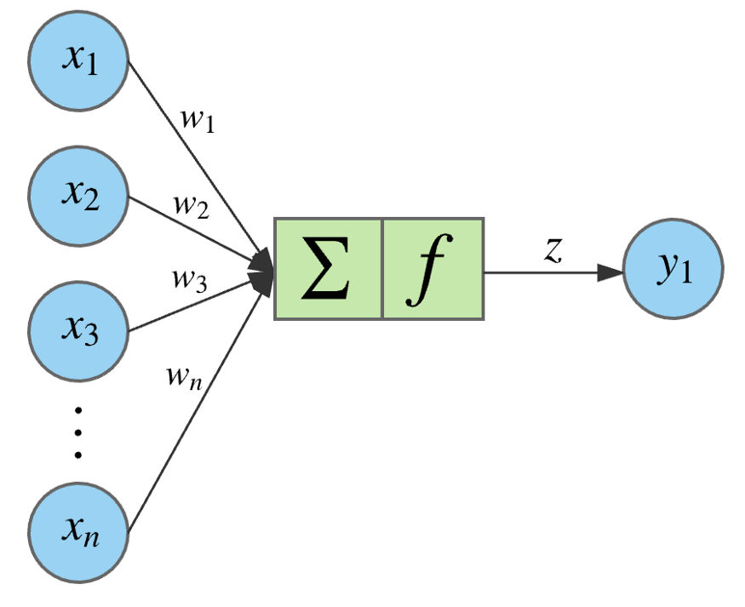
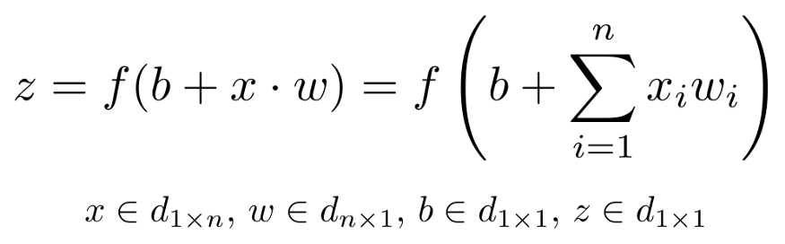
Non-linearity
A given node takes the weighted sum of its inputs, and passes it through a non-linear activation function.
If we zoom in to one of the hidden or output nodes, what we will encounter is the figure below.

Slide 21
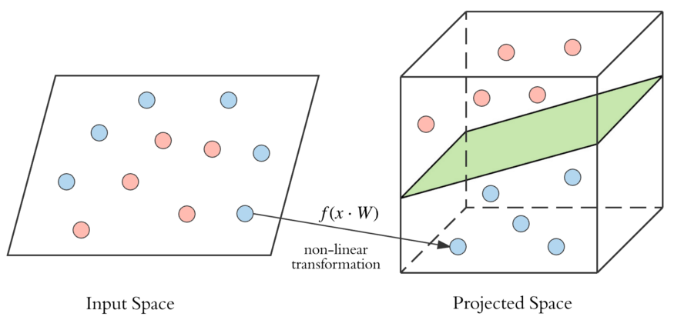
Why Non-Linearity?
Data linearly separable: By performing non-linear transformations at each layer, we are able to project the input to a new vector space, and draw a complex decision boundary to separate the classes.
Non Separable data→ Non-linear transformation
→Linearly
separable.

Slide 22
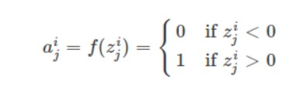
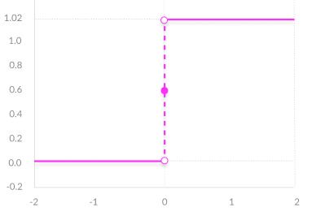
Activation Functions
Step Function
A step function is generally used in the Perceptron linear classifier. It thresholds the input values to 1 and 0, if they are greater or less than zero, respectively.
The step function is mainly used in binary classification problems and works well for linearly severable . It can’t classify the multi-class problems.

Slide 23
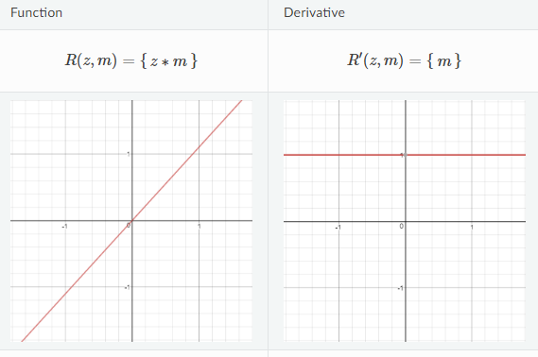
Activation Functions(Contd..)
Linear Activation Function
The equation for Linear activation function is: f(x) = a.x
When a = 1 then f(x) = x and this is a special case known as identity.
Properties:
Range is -infinity to +infinity
Provides a convex error surface
so optimization can be achieved faster
df(x)/dx = a which is constant. So
cannot be optimized with gradient descent
Limitations:
Since the derivative is constant, the
gradient has no relation with input
Back propagation is constant as the
change is delta x

Slide 24
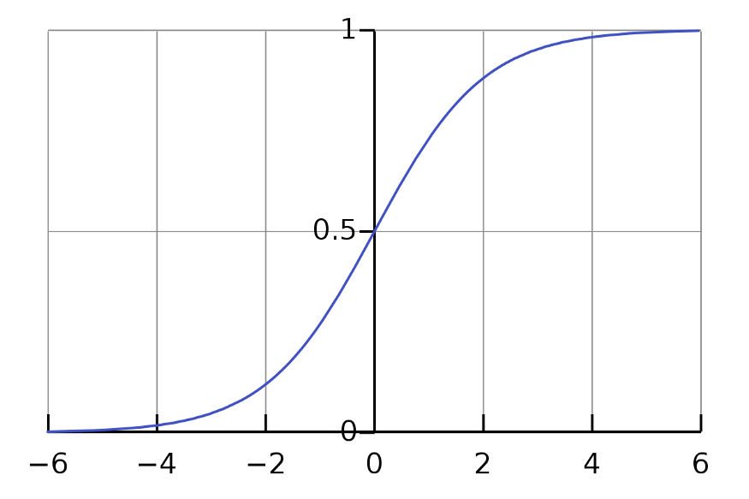
Activation Functions(Contd..)
Sigmoid:
The sigmoid activation function has the mathematical form : sig(z) = 1/ (1 + e^-z).
Takes a real valued number as the input and squashes it between 0 and 1.
Two major drawbacks:
Killing gradients.
Non zero-centered
outputs

Slide 25
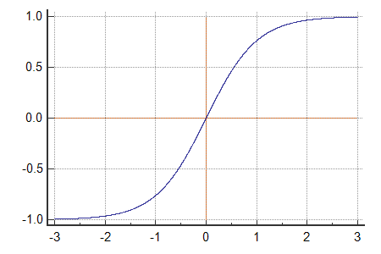
Activation Functions(Contd..)
Tanh:
The mathematical form tanh(z) = (e^z — e^-z) / (e^z + e^-z)
Shifted sigmoid neuron. Killing gradients but zero centered
Takes a real valued number and squashes it between -1 and +1.

Slide 26

Activation Functions(Contd..)
ReLU:
Rectified Linear Unit is represented as `ReLU(z) = max(0, z)`.
Thresholds the inputs at zero.
Greatly accelerates the convergence of stochastic gradient descent.
Sparsity of Activations.
Dead Neurons: Zero gradients
flow through initially
not activated neurons.

Slide 27
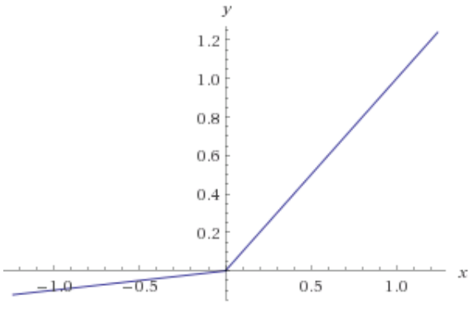
Activation Functions(Contd..)
Leaky ReLU:
It is represented as `LeakyReLU(z) = max(0.01 * z, z)`
Dead Neurons problem is not exist here

Slide 28
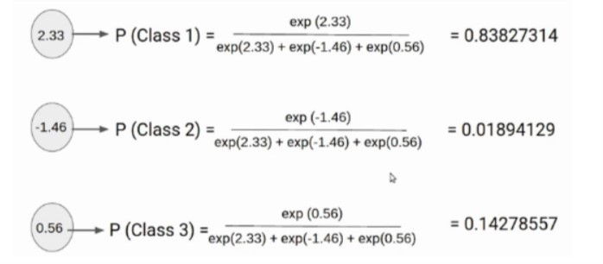
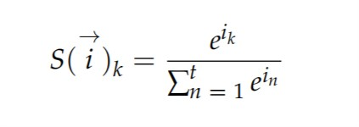
Softmax Activation Function
Softmax , is used in the output layer that produces the probability distribution of multiple classes.
Outputs probabilistic values ranging from 0 to 1 , summing up 1.
Softmax activation function generates probability
distribution by using the following equation:

Slide 29
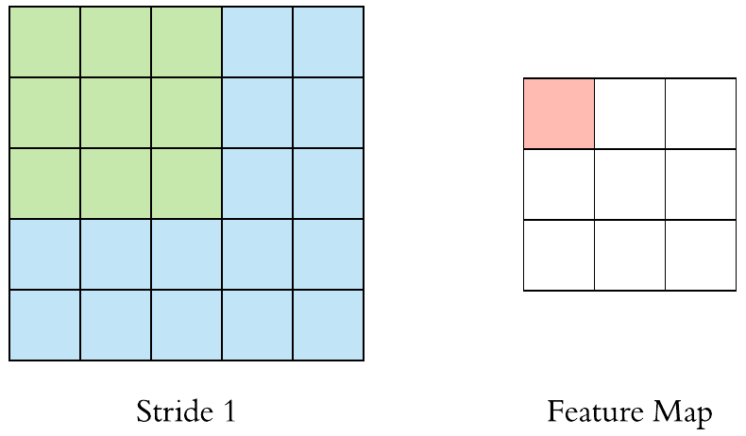
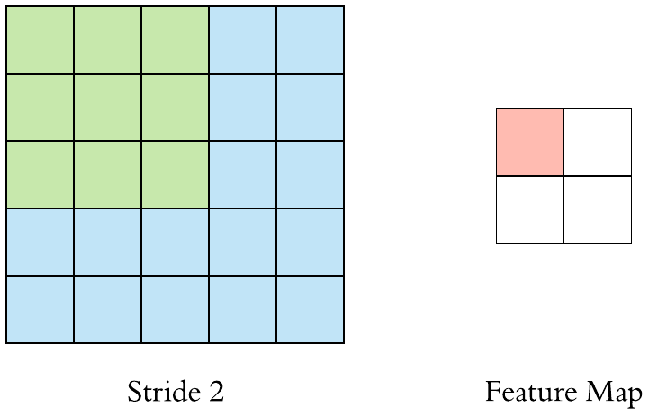
Stride
Stride specifies how much we move the convolution filter at each step.
Bigger strides can be used if we want less overlap between the receptive fields.

Slide 30
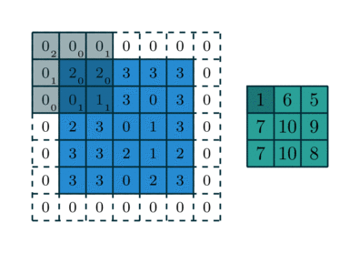
Padding
If we want to maintain the same dimensionality, we can use padding to surround the input with zeros.
"valid", which means no padding (only valid window locations will be used);
and "same", which means “pad in such a way as to have an output with the same width
and height as the input.” The padding argument defaults to valid.
Padding is commonly used in CNN to preserve the size of the feature maps, otherwise they would shrink at each layer, which is not desirable.

Slide 31
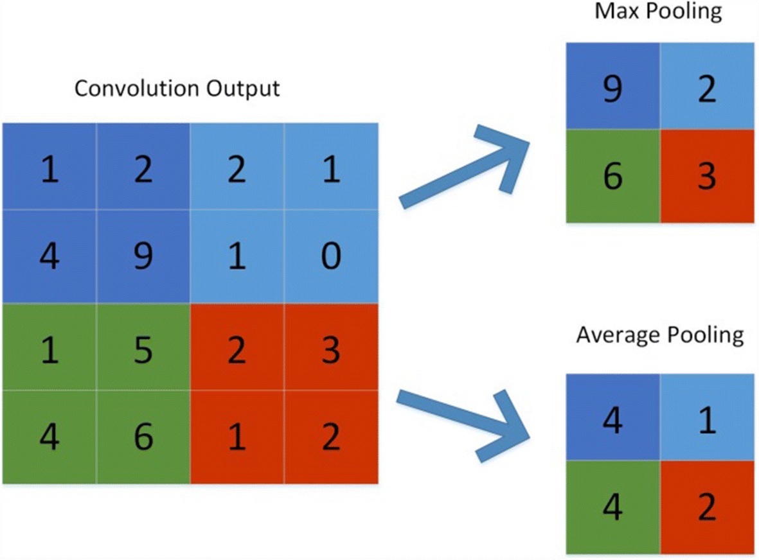
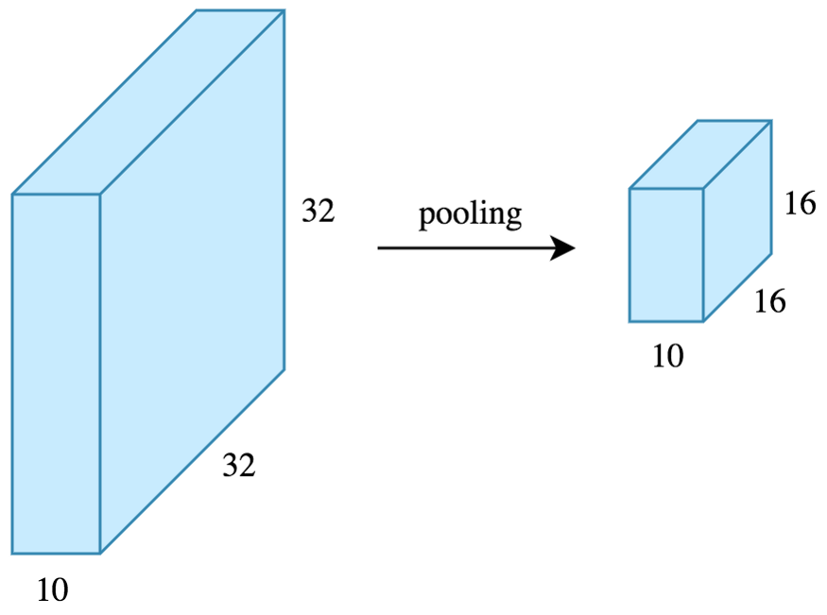
Pooling
Pooling is performed to reduce the dimensionality which
enables us to reduce the number of parameters, which both shortens the training time and combats overfitting.
The most common type of pooling is max pooling which just takes the max value in the pooling window.Besides Average pooling is also used.
Contrary to the convolution operation, pooling has no parameters.

Slide 32
Pooling(Contd..)
Why we need Pooling layers:
Convolutional layers represent the presence of features in an input image. But they present a problem, they're sensitive to location of features in the input.
This gives us specific data rather than generalised data, deepening the problem of overfitting and doesn't deliver good results for data outside the training set.
So we need to generalise the presence of features. This is done by means of pooling layers.

Slide 33
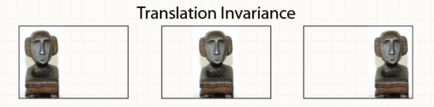
Pooling(Contd..)
When to use what type of pooling:
Max Pooling benefits translation invariance:
When a model is translation invariant, it means that it doesn’t matter where an object is present in a picture; it will be recognized anyway. For example, if I hold a phone near my head, or near my pocket – it should be part of the classification both times.
Achieving translation invariance in your model greatly benefits its predictive power, as you no longer need to provide images where the object is precisely at some desired position. Rather, you can just provide a massive set of images that contain the object, and possibly get a well-performing model.

Slide 34
Pooling(Contd..)
Why Max Pooling is the most used pooling operation :
The argument is relatively simple: as the objects of interest likely produce the largest pixel values, it shall be more interesting to take the max value in some block than to take an average (Chollet, 2017).
Why think about Average Pooling at all:
If the position of objects is not important, it seems that better results can be achieved with Average Pooling.

Slide 35
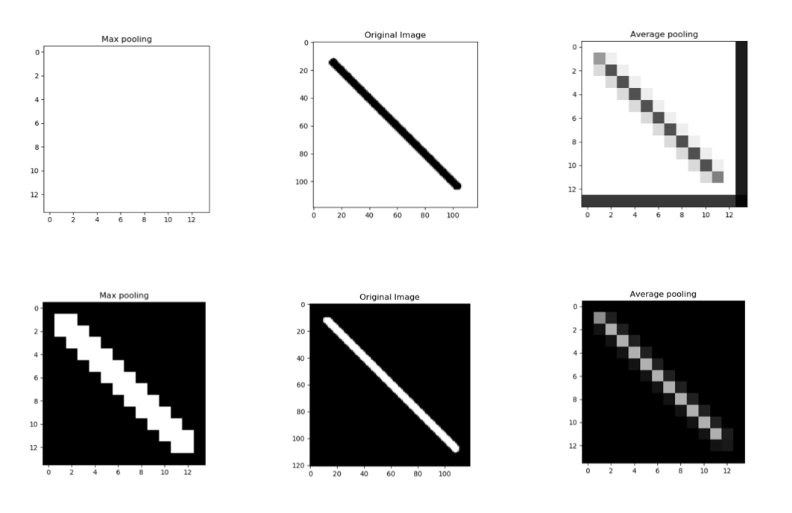
Pooling(Contd..)
Type of image:
Max pooling works better for darker backgrounds and can thus highly save computation cost whereas average pooling shows a similar effect irrespective of the background.
Max pooling worked really well for generalising the line on the black background, but the line on the white background disappeared totally!Average pooling can save you from such drastic effects.

Slide 36
Weight Initialization
Types of weight intializations:
A too-small initialization leads to vanishing gradients
Every neuron in the network computes the same output →→ computes the same gradient →→ same parameter updates.
The values of the activation a[l] decrease exponentially with l. When these activations are used in backward propagation, this leads to the vanishing gradient problem.

Slide 37
Weight Initialization(Contd..)
A too-large initialization leads to exploding gradients
The values of a[l] increase exponentially with l. When these activations are used in backward propagation, this leads to the exploding gradient problem.
Normal Initialization: set all weights to random small numbers
Every neuron in the network computes different
output →→ computes different gradient →→ different
parameter updates.
“Symmetry breaking”
Problem: variance that grows with the number of
inputs.

Slide 38
Weight Initialization(Contd..)
How to find appropriate initialization values:
To prevent the gradients of the network’s activations from vanishing or exploding, we will stick to the following rules of thumb:
1.The mean of the activations should be zero.
2.The variance of the activations should stay the
same across every layer.
Xavier initialization follows the above mentioned rules.

Slide 39
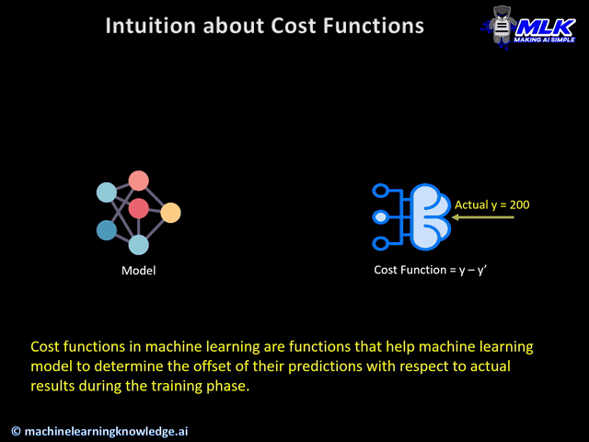
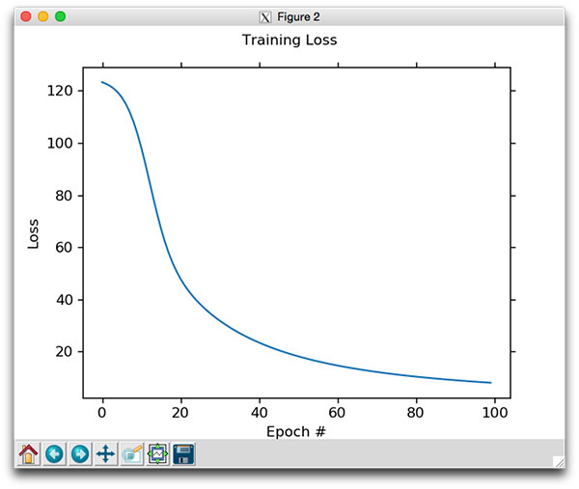
Loss Function Introduction
A loss function maps decisions to their associated costs.
Loss Functions also help in finding out the slope i.e. gradient w.r.t. weights used in the model and then these weights are updated after each epoch with the help of backpropagation.
What’s the Difference between a Loss Function and a Cost Function?
A loss function is for a single training example. It is also sometimes called an error function. A cost function, on the other hand, is the average loss over the entire training dataset. The optimization strategies aim at minimizing the cost function.

Slide 40
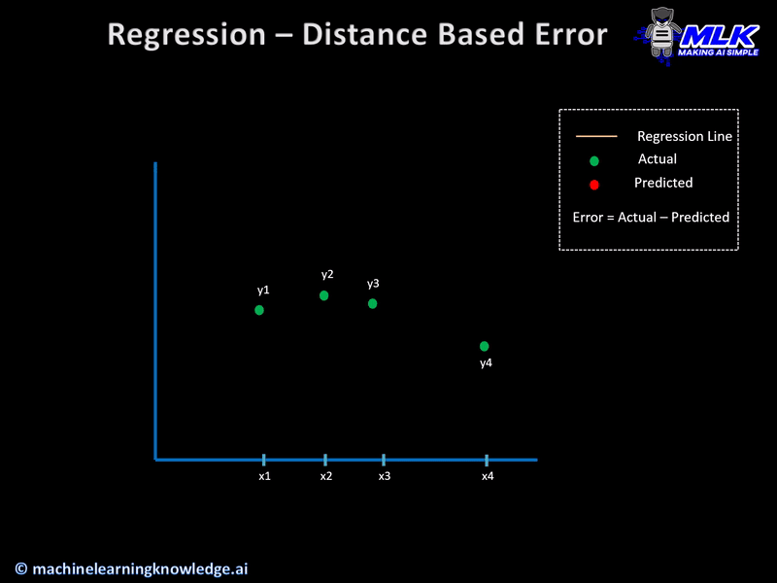
Regression Loss Functions
The cost functions for regression are calculated on distance-based error.Let us say that for a given set of input data, the actual output was y and our regression model predicts y’ then the error in prediction is calculated simply as
Error = y-y’
Regression Based Loss functions are:
1.Mean Absolute Error (MAE).
2.Mean Absolute Percentage Error (MAPE).
3.Mean Squared Error (MSE).
4.Root Mean Squared Error (RMSE).
5.Huber Loss.
6.Log-Cosh Loss.

Slide 41
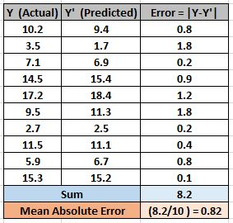
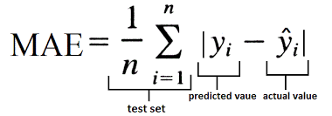
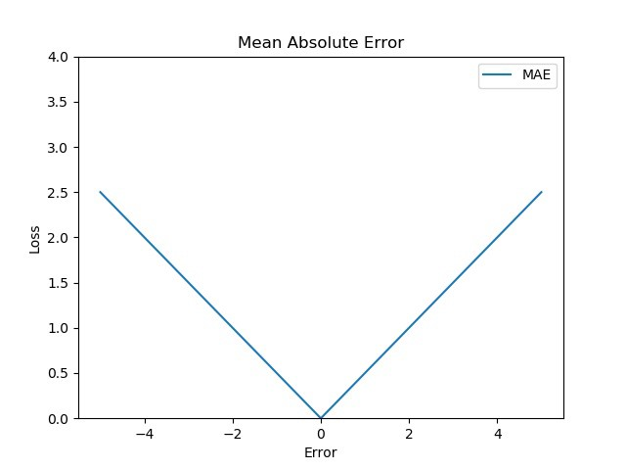
Mean Absolute Error
MAE calculates the absolute difference (discards the sign) between the actual and predicted values and takes it’s mean.
MAE is a linear scoring method, i.e. all the errors are weighted equally while calculating the mean. This means that while backpropagation, we may just jump past the minima due to MAE’s steep nature.
MAE suffers scaling problem.

Slide 42
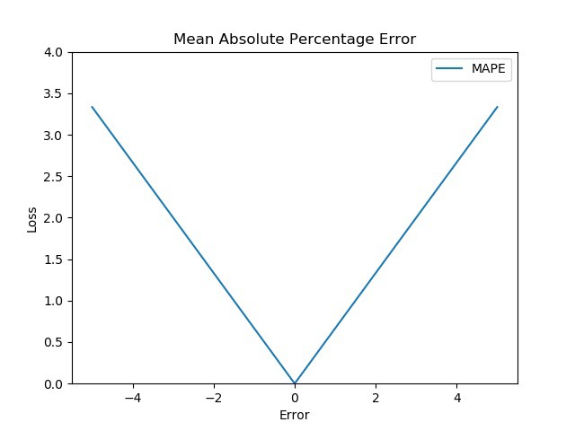
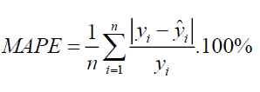
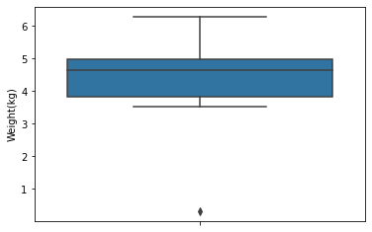
Mean Absolute Percentage Error (MAPE)
MAPE is similar to that of MAE, with one key difference, that it calculates error in terms of percentage, instead of raw values. Due to this, MAPE is independent of the scale of our variables.
Loss is calculated by normalizing all errors on a common scale (of hundred).

Slide 43
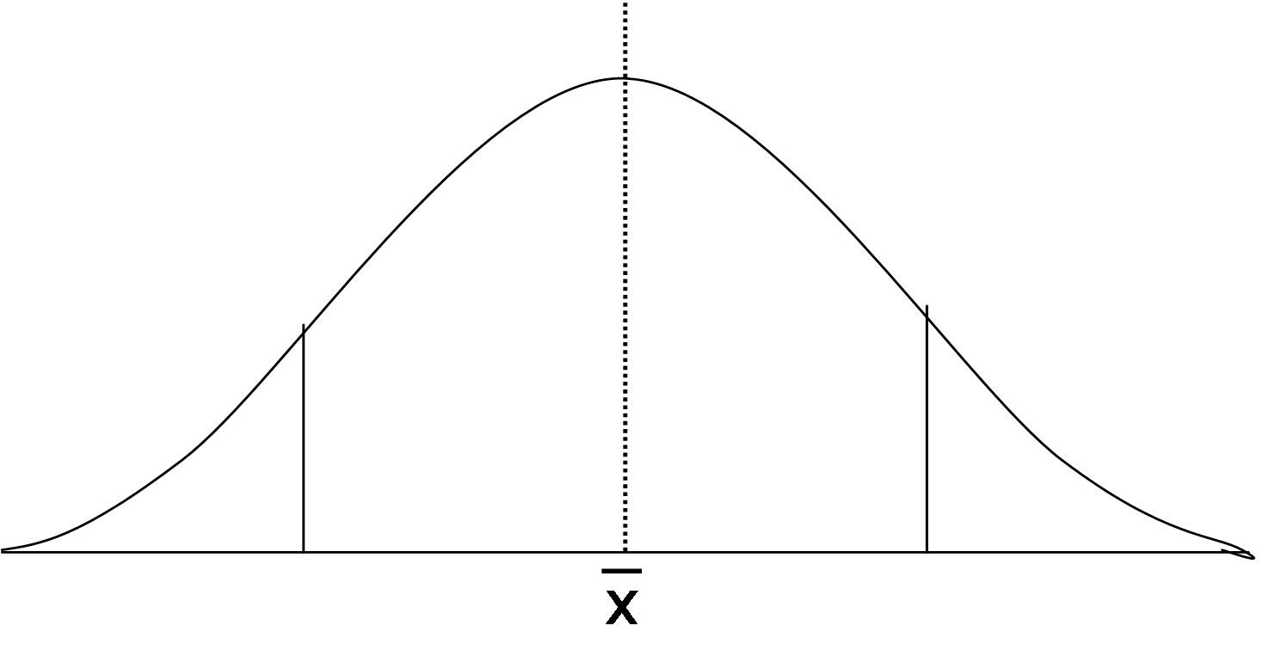
The concept of percentile
Percentiles indicate the percentage of scores that fall below a particular value. They tell you where a score stands relative to other score.
First Quartile
(25th percentile)
Median
(50th percentile)
Third Quartile
(75th percentile)
Median / 50th percentile
1st quartile / Q1
Lower quartile/ 25th percentile
3rd quartile / Q3 / Upper quartile/ 75th percentile
25% of the dataset
25% of the dataset
25% of the dataset
25% of the dataset

Slide 44
Interquartile range (IQR)
The interquartile range defines the difference between the third and the first quartile.
interquartile range = Upper Quartile – Lower Quartile = Q­3 – Q­1
First Quartile
(25th percentile)
Median
(50th percentile)
Third Quartile
(75th percentile)
Median / 50th percentile
1st quartile / Q1
Lower quartile/ 25th percentile
3rd quartile / Q3 / Upper quartile/ 75th percentile
25% of the dataset
25% of the dataset
25% of the dataset
25% of the dataset
25% of the dataset
25% of the dataset
Q3 - Q1

Slide 45
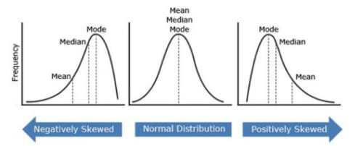
Normal distribution
Mean is the average of all numbers.
Median is the middle value of the set.
Mode is the value that occurs the most.

Slide 46

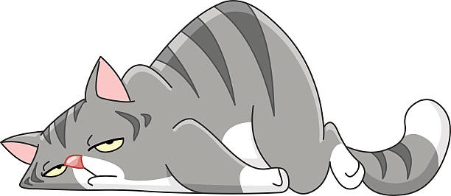
An Example
Is Your Cat Fat?
You are so fat!!!
Prove it, Master.
3.5 kg

Slide 47
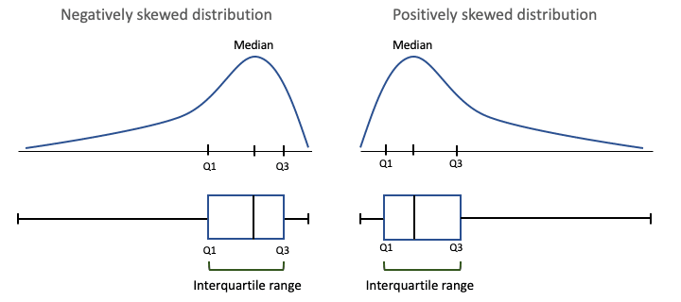

Interquartile Range (IQR)
For negative skewed distribution and positive skewed distribution IQR is different from Standard Normal Distributions IQR.
3.5

Slide 48


Mistake In Dataset
If you have made a mistake while taking input...
You wrote 0.3

Slide 49
Identifying Mistakes
Boxplot gives us the mistaken or significant values normally not expected.

Slide 50
Outliers
An outlier is an observation that lies an abnormal distance from other values in a random sample from a population.
value < (Q1 - 1.5 x IQR)
value > (Q3 + 1.5 x IQR)
Q1 - 1.5 x IQR
Q3 + 1.5 x IQR
25% of the dataset
25% of the dataset
Q3 - Q1

Slide 51



Mean Squared Error (MSE)
We calculate the square of our error and then take it’s mean. This is a quadratic scoring method, meaning, the penalty is proportional to not the error (like in MAE), but to the square of the error, which gives relatively higher weight (penalty) to large errors/outliers, while smoothening the gradient for smaller errors.
MSE is also sensitive to outliers, i.e. outliers in data may impact our network more, as the loss for these will be considerably higher.

Slide 52


Root Mean Squared Error (RMSE)
RMSE is just the square root of MSE, which means, it is again, a linear scoring method, but still better than MAE as it gives comparatively more weightage to larger errors.
RMSE is still a linear scoring function, so again, near minima, the gradient is sudden.

Slide 53


MSE Vs MAE
MSE penalizes small errors:
In MSE, since each error is squared, it helps to penalize even small deviations in prediction when compared to MAE.
If your data is free from noise or outliers, then it is good to use MSE as it will rightly penalize the errors in prediction much better than MAE.
MSE has an adverse effect on Outliers:
If your data has noise or outliers, then overall MSE will be amplified which is not good. In this case, it is better to use MAE.

Slide 54


Huber Loss
Huber loss is a superb combination of linear as well as quadratic scoring methods. It has an additional hyperparameter delta (δ). Loss is linear for values above delta and quadratic below delta. This parameter is tunable according to your data, which makes the Huber loss special.
Due to additional conditionals and comparisons, Huber loss is comparatively expensive in terms of computations, especially if your dataset is large.

Slide 55


Log-Cosh Loss
Graphically, Log-cosh is quite similar to Huber loss as it is also a combination of linear and quadratic scorings.
One difference that sets this apart is that it is double differentiable. Some optimization algorithms like XGBoost prefer such functions over Huber, which is differentiable only once
Where, p = predicted value and t = true value.

Slide 56


Cost functions for Classification problems
Cross Entropy Intuition:
Cross Entropy can be considered as a way to measure the distance between two probability distributions.
Cross entropy is a tool to calculate how much far is the predicted probability distribution from the actual one.

Slide 57




Binary Cross Entropy Loss
A greater value of entropy for a probability distribution indicates a greater uncertainty in the distribution. Likewise, a smaller value indicates a more certain distribution.
This makes binary cross-entropy suitable as a loss function – you want to minimize its value.
Now, let’s assign some colors to our points: red and green. These are our labels.

Slide 58

The Support Vector Machine
SVM is a supervised machine learning algorithm that can be used for classification or regression problems.
It does some extremely complex data transformations, then figures out how to separate your data based on the labels or outputs you’ve defined

Slide 59

Hyperplane
A hyperplane is a decision plane that separates between a set of objects having different class memberships.
The dimension of the hyperplane is directly proportional to the number of features.
For a simple linear regression model if your data is based on a single feature then your plane/decision boundary would look like left side image.

Slide 60




Margin
A margin is a gap between the two lines on the closest class points. This is calculated as the perpendicular distance from the line to support vectors or closest points.
If the margin is larger in between the classes, then it is considered a good margin, a smaller margin is a bad margin.
Thus it can be interpreted that hinge loss is max(0,1-Zi).

Slide 61


Hinge Loss
Hinge loss is another cost function that is mostly used in Support Vector Machines (SVM) for classification.
To work with hinge loss, the binary classification output should be denoted with +1 or -1.SVM predicts a classification score h(y) where y is the actual output. Then hinge loss for a particular data D is given as-
Hinge_Loss(D) = max(0,1-y*h(y))

Slide 62


Categorical Cross-Entropy
This cost function is used in the classification problems where there are multiple classes and input data belongs to only one class.
The loss for input vector X_i and the corresponding one-hot encoded target vector Y_i is:

Slide 63


Why Not Regression Losses in Classification?
Overconfident wrong prediction:
Sometimes machine learning model, especially during the training phase not only makes a wrong classification but makes it with so confidence that they deserve much more penalization.Binary Cross Entropy is doing a more severe penalty than MAE or MSE for this situation.

Slide 64

Choosing the right last-layer activation and loss function
Regarding the choice of a loss function, note that it isn’t always possible to directly optimize for the metric that measures success on a problem. Sometimes there is no easy way to turn a metric into a loss function; loss functions.

Slide 65


Optimization Algorithms
In machine/deep learning terminology, it’s the task of minimizing the cost/loss function J(w).
Optimization algorithms have one of the following goals:
1. Find the global minimum of the objective function. This is feasible if the objective function is convex.
2. Find the lowest possible value of the objective function within its neighborhood , if the objective function is not convex as the case in most deep learning problems.
Optimization algorithms are:
1.Gradient decent
2.RMS Prop
3.Adam
4.Adagrad/Ada-delta

Slide 66


Gradient Descent
Gradient Descent is an optimizing algorithm used in Machine/ Deep Learning algorithms. The goal of Gradient Descent is to minimize the objective error/loss function f(x) using iteration.
Error = Y (Predicted)-Y(Actual), this error is reduced by gradient decent algorithm.

Slide 67

Gradient Decent(Contd..)
Derivative ,the slope of the graph at a particular point, gives the desired direction to reach the minima.
In order to get pointer to minima ,we need to walk some steps known as learning rate(Alpha).

Slide 68


Gradient Decent(Contd..)
Learning rate must be chosen wisely as:
If it is too small, then the model will take some time to learn.
If it is too large, model will converge as our pointer will shoot and we’ll not be able to get to minima.

Slide 69


Gradient Decent(Contd..)
Decay Learning rate: When the decay argument is specified, it will decrease the learning rate from the previous epoch by the given fixed amount.
Drop Based Learning rate: Systematically drop the learning rate at specific times during training,often dropping by half every fixed number of epochs.

Slide 70

Gradient Decent(Contd..)
A systematic approach towards finding the optimal learning rate: The best learning rate is associated with the steepest drop in loss, so we're mainly interested in analyzing the slope of the plot.

Slide 71

Problems with Gradient Decent
Local Minima : Gradient Descent gets trapped in local minima.
Plateau : At the plateau, the gradient at each dimension is still near 0 and the model updates slowly as well.

Slide 72


Gradient Descent With Momentum
Momentum is a value between 0 and 1 that increases the size of the steps taken towards the minimum by trying to jump from a local minima.
A large value of momentum means that the convergence will happen fast.
A small value of momentum cannot reliably
avoid local minima, and can also slow down the
training of the system.
Momentum also helps in smoothing out the
variations, if the gradient keeps changing
direction.

Slide 73

Variants of Gradient descent
1.Batch Gradient Descent: All the training data is taken into consideration to take a single step. Just one step of gradient descent in one epoch.
Great for convex or relatively
smooth error manifolds
, directly towards an optimum
solution.
For huge dataset ,it is not
efficient for computational
difficulty.

Slide 74

Variants of Gradient descent(Contd..)
2. Stochastic Gradient Descent: We consider just one sample at a time to take a single step.
SGD can be used for larger datasets. It converges faster when the dataset is large as it causes updates to the parameters more frequently.
Since we are considering just one example at a time the cost will fluctuate over the training examples .It will never reach the minima but it will keep dancing around it.

Slide 75

Variants of Gradient descent(Contd..)
Stochastic gradient Decent VS Batch Gradient Decent :
1.First, SGD converges much more rapidly than batch gradient descent.
2.Secondly, despite what the average cost function plot says, batch gradient descent after 1000 iterations outperforms SGD.
This is because SGD is noisy.
It can act to “kick” the
gradient descent out of local
minimum values of the cost
function , it can also hinder it
settling down into a good
minimum.

Slide 76

Variants of Gradient descent(Contd..)
3.Mini-Batch Gradient Decent:
A mixture of Batch Gradient Descent and SGD is used. We use a batch of a fixed number of training examples which is less than the actual dataset and call it a mini-batch.
Mini-batch gradient descent appears be the superior method of gradient descent to be used in neural networks training.
Kicks the cost function out of
local minimum values to reach
better, perhaps even the best,
minimum.
Mini-batch gradient descent
is that it can be performed
in a distributed manner

Slide 77


AdaGrad
Keeps track of the sum of gradient squared and uses that to adapt the gradient in different directions.
Some features are very sparse.
AdaGrad solves this problem by
Changing learning rate.
It makes big updates for less frequent parameters
and a small step for frequent parameters.
AdaGrad will take a straight path,
whereas gradient descent takes the
approach of “let me slide down the
steep slope first and maybe worry
about the slower direction later,
Thus falls in saddle point.

Slide 78
AdaGrad(Contd...)
Advantages:
1. Learning rate changes for each training parameter.
2. Don’t need to manually tune the learning rate.
3. Able to train on sparse data.
Disadvantages:
1. Computationally expensive as a need to calculate the second order derivative.
2. The learning rate is always decreasing results in slow training.

Slide 79


Exponentially Moving Average
An exponential moving average (EMA) is a type of moving average that places a greater weight and significance on the most recent data points.
Reacts more significantly to recent price changes than a simple moving average , which applies an equal weight to all observations in the period.

Slide 80
AdaDelta
It is an extension of AdaGrad which tends to remove the decaying learning Rate problem of it.
Instead of accumulating all previously squared gradients, Ada-delta limits the window of accumulated past gradients to some fixed size w.
In this exponentially moving average is used rather than the sum of all the gradients.
Advantages:
1.Now the learning rate does not decay and the training does not
stop.
Disadvantages:
1.Computationally expensive.

Slide 81


RMSProp — Root Mean Square Propagation
Intuition:AdaGrad decays the learning rate very aggressively (as the denominator grows). As a result, after a while, the frequent parameters will start receiving very small updates because of the decayed learning rate. To avoid this why not decay the denominator and prevent its rapid growth.
AdaGrad got stuck when it was
close to convergence, because of the
decayed learning rate. RMSProp
overcomes this problem.

Slide 82

Adam
Adam (Adaptive Moment Estimation) works with momentums of first and second order.
The intuition behind the Adam is that we don’t want to roll so fast just because we can jump over the minimum, we want to decrease the velocity a little bit for a careful search.
In addition to storing an exponentially decaying average of past squared gradients like AdaDelta, Adam also keeps an exponentially decaying average of past gradients M(t).
Advantages:
The method is too
fast and converges rapidly.
Rectifies vanishing learning
rate, high variance.
Disadvantages:
Computationally costly.

Slide 83
Which Algorithm to Use?
If your input data is sparse, one of the adaptive
learning-rate methods works best.
RMSprop is an extension of Adagrad that
deals with its radically diminishing learning rates.
It is identical to Adadelta.
Adam, finally, adds bias-correction and
momentum to RMSprop. Insofar, RMSprop,
Adadelta, and Adam are very similar algorithms that
do well in similar circumstances. Insofar, Adam
might be the best overall choice.
Many recent papers use vanilla SGD without
momentum and a simple learning rate annealing
Schedule , But for fast convergence and
train a deep or complex neural network,
choose one of the adaptive learning rate methods.

Slide 84

Forward Propagation
Each Perceptron will propagate its value into Perceptrons in the proceeding layer, and eventually, arrive at the output layer. This process is called Forward Propagation.

Slide 85

Back Propagation
A Cost Function is then used to calculate the difference between the expected result and the output of the neural network in forward propagation and used to adjust the Weight and Biases of the previous layer. The process propagates backward in layers, and thus it is called “Back Propagation”.

Slide 86


Data Augmentation
Few examples to train on, resulting in a model that has poor generalization performance.
Common transformations are: rotation, shifting, resizing, zoom in , flipping etc.

Slide 87

Dropout
During training time, at each iteration, a neuron is temporarily “dropped” or disabled with probability p. This means all the inputs and outputs to this neuron will be disabled at the current iteration.
Randomly removing a different subset of neurons on each example would prevent conspiracies and thus reduce over_x0002_fitting.
By introducing noise in the output values of a layer can break up happenstance patterns that aren’t significant (what Hinton refers to as conspiracies), which the network will start memorizing if no noise is present.

Slide 88

Batch Normalization
Batch Normalization, is a process to make neural networks faster and more stable through adding extra layers in a deep neural network.
Normalization is the process of transforming the data to have a mean zero and standard deviation one.

Slide 89

Transfer Learning
Transfer learning is the improvement of learning in a new task through the transfer of knowledge from a related task that has already been learned.
Motivation for Transfer Learning:
Humans don’t learn everything from the ground up and leverage and transfer their knowledge from previously learnt domains to newer domains and tasks.
To solve complex problems need a whole lot of data, and getting vast amounts of labeled data for supervised models can be really difficult.

Slide 90


Understanding Transfer Learning
Transfer learning enables us to utilize knowledge from previously learned tasks and apply them to newer, related ones.

Slide 91

Task & Domain

Slide 92

The Domain Adaptation
To fill the gap between Source data (train data) and Target data (Test data) a concept called domain adaptation is used.

Slide 93

Architecture of DDA(Using Transformation)
This method has achieved nearly 70% of accuracy when a simple CNN model is trained on MNIST data and validated over the MNIST-M dataset.

Slide 94

Methodology of DDA
The linear operation like cross-correlation is denoted by the circled cross symbols and as usual, the star symbols denote the convolution operation.

Slide 95


Transfer Learning Application

Slide 96

When to Use Transfer Learning?
Three possible benefits to look for when using transfer learning:
1.Higher start: The initial skill (before refining the model) on the source model is higher than it otherwise would be.
2.Higher slope: The rate of improvement of skill during training of the source model is steeper than it otherwise would be.
3.Higher asymptote:The converged skill of the trained model is better than it otherwise would be.

Slide 97

Transfer Learning for Deep Learning
Deep learning models are representative of what is also known as inductive learning.
The objective for inductive-learning algorithms is to infer a mapping from a set of training examples.
To generalize well on unseen data,algorithm works with a set of assumptions related to the distribution of the training data. These sets of assumptions are known as inductive bias.
Inductive biases of the source task to assist the target task are utilized by narrowing down the hypothesis space,or making adjustments to the search process itself with the help of knowledge from the source task.

Slide 98


Pre-trained Models as Feature Extractors
The key idea here is to just leverage the pre-trained model’s weighted layers to extract features but not to update the weights of the model’s layers during training with new data for the new task.

Slide 99

Fine Tuning Pre-trained Models
Deep neural networks are highly configurable architectures with various hyperparameters.
Initial lower layers of the network learn very generic features and the higher layers learn very task-specific features.

Slide 100


Fine Tuning Pre-trained Models (Contd...)
Using previous insight, we may freeze (fix weights) certain layers while retraining, or fine-tune the rest of them to suit our needs.

Slide 101

Why only reuse the convolutional base?
1.The representations learned by the convolutional base are likely to be more generic and therefore more reusable: the feature maps of a convnet are presence maps of generic concepts over a picture, which is likely to be useful regardless of the computer-vision problem at hand.
2.Representations found in densely connected layers no longer contain any information about where objects are located in the input image
3.These layers get rid of the notion of space.

Slide 102
Why not fine-tune more layers?
Why not fine-tune the entire convolutional base?
We can but but you need to consider the following:
○ 1.It’s more useful to fine-tune the more specialized features, because these are the ones that need to be repurposed on your new problem. There would be fast-decreasing returns in fine-tuning lower layers.
○ 2.The more parameters you’re training, the more you’re at risk of overfitting.The convolutional base has 15 million parameters, so it would be risky to attempt to train it on your small dataset.
Thus, in this situation, it’s a good strategy to fine-tune only the top two or three layers in the convolutional base.

Slide 103


Things to Keep in Mind While Fine Tuning
Start with the Adam or RMSProp optimizer, using a very low learning rate. The reason for using a low learning rate is that you want to limit the magnitude of the modifications. Updates that are too large may harm these representations.
These curves look noisy. To make them more readable, you can smooth them by replacing every loss and accuracy with exponential moving averages of these quantities.

Slide 104

Freeze or Fine-Tune?

Slide 105

Freeze or Fine Tune(Contd...)
Transfer learning with Fine tuning improves generalization.

Slide 106


How The Number Of Learnable Parameters Is Calculated?
The number of learnable parameters:
inputs * outputs + biases
=> 3*2*3*3+2=56

Slide 107

Major Innovations For Transfer Learning
Computer Vision had come a long way since the initial Perceptron experiments back in 1959.
Back in 1980,Fukushima proposed “neocognitron”.
Later in 1998, Yann LeCun et al. at Bell Labs proposed Le-Net-5,the first to propose the idea of backpropagation – using gradient-based learning for training a mode.
The launch of the ImageNet Challenge in 2011/12 paved the way for several new innovations in the field of computer vision.
Using the ImageNet database, Alex Krizhevsky proposed the AlexNet – a CNN-based network in 2012. error rate in ImageNet Challenge to 16.4%.
In 2014, GoogLeNet by Google proposed the use of inception modules to reduce the problem of exploding or vanishing gradients. It was a significant jump from 22 to 152 layers by the use of skip connections.

Slide 108
VGG – The Idea
What was new in this model?
The idea behind using 3 x 3 filters uniformly is something that makes the VGG stand out. Two consecutive 3 x 3 filters provide for an effective receptive field of 5 x 5. Similarly, three 3 x 3 filters make up for a receptive field of 7 x 7. This way, a combination of multiple 3 x 3 filters can stand in for a receptive area of a larger size.
It also reduces the number of weight parameters in the model significantly.
What is the benefit of using three 3 x 3 layers instead of a single 7 x 7 layer?
In addition to the three convolution layers, there are also three non-linear activation layers instead of a single one you would have in 7 x 7. This makes the decision functions more discriminative. It would impart the ability to the network to converge faster.

Slide 109

VGG 16 Architecture
The input to any of the network configurations is considered to be a fixed size 224 x 224 image with three channels – R, G, and B. The only pre-processing done is normalizing the RGB values for every pixel. This is achieved by subtracting the mean value from every pixel.

Slide 110

Recurrent Neural Networks
Sequence Data:
RNN’s are neural networks that are good at modeling sequence data.
Say you take a still snapshot of a ball moving in time.
What is the direction that the ball is moving?
Any answer would come up with would be that, a random guess.
Without knowledge of where the ball has been, you wouldn’t have enough data to predict where it’s going.

Slide 111


Sequence Data(Contd...)
If we record many snapshots of the ball’s position in succession, you will have enough information to make a better prediction.
Audio is a natural sequence. We can chop up an audio spectrogram into
chunks and feed that into RNN’s.
Text is another form of sequences. We can break Text up into a sequence of
characters or a sequence of words.

Slide 112
Sequential Memory
Intuition behind what sequential memory means:
If we were taught this specific sequence, it should come quickly to us.
Let’s start at the letter F.
F..........G....H....I....J...K...L
At first, you’ll struggle with the first few letters, but then after your brain picks up the pattern, the rest will come naturally

Slide 113


Recurrent Neural Networks
let’s look at a traditional neural network also known as a feed-forward neural
network.
(i) It has its input layer,
(ii)hidden layer, and
(iii)the output layer.
An RNN has a looping mechanism that acts as a highway to allow information to flow from one step to the next.

Slide 114


Recurrent Neural Networks(Contd...)
RNN use case:
Let’s say we want to build a chatbot.
First, we are going to encode the sequence of text using an RNN. Then, we are going to feed the RNN output into a feed-forward neural network which will classify the intents.
What time is it?
To start, we break up the sentence
into individual words.

Slide 115


Use Case(Contd...)
1.The first step is to feed “What” into the RNN. The RNN encodes “What” and
produces an output.
2.For the next step, we feed the word “time” and the hidden state from the previous step. The RNN now has information on both the word “What” and “time”.

Slide 116


Use Case(Contd...)
3.We repeat this process, until the final step. You can see by the final step the
RNN has encoded information from all the words in previous steps.
4.Since the final output was created from the rest of the sequence, we should be able to take the final output and pass it to the feed-forward layer to classify an intent.

Slide 117

Vanishing Gradient
Short-Term memory and the
vanishing gradient is due to the nature
of back-propagation;
When doing back propagation, each
node in a layer calculates it’s gradient
with respect to the effects of the
gradients, in the layer before it.
That causes gradients to exponentially
shrink as it back propagates down.

Slide 118

Vanishing Gradiant in RNN
We can think of each time step in a recurrent neural network as a layer.
To train a recurrent neural network, you use an application of back-propagation called back-propagation through time.
The gradient values will exponentially shrink as it propagates through each time step.
Because of vanishing gradients, the RNN doesn’t learn the long-range dependencies across time steps.

Slide 119

LSTM’s and GRU’s as a Solution
LSTM ’s and GRU’s were created as the solution to short-term memory.
They have internal mechanisms called gates that can regulate the flow of information.
These gates can learn which data in a sequence is important to keep or throw away(pass relevant information down the long chain of sequences to make predictions)

Slide 120

Intuition
Let’s say you’re looking at reviews online to determine if you want to buy something.

Slide 121

Intuition(Contd...)
An LSTM or GRU can learn to keep only relevant information to make predictions, and forget non relevant data.

Slide 122


RNN Processing
First words get transformed into machine-readable vectors.
Then the RNN processes the sequence of vectors one by one.
While processing, it passes the previous hidden state to the next step of the sequence.
The hidden state acts as the neural networks memory. It holds information on previous data the network has seen before.

Slide 123

RNN Cell
First, the input and previous hidden state are combined to form a vector.
That vector now has information on the current input and previous inputs.
The vector goes through the tanh activation, and the output is the new hidden state, or the memory of the network.

Slide 124


Tanh activation
The tanh activation is used to help regulate the values flowing through the network.
The tanh function squishes values to always be between -1 and 1.
When vectors are flowing through a neural network, it undergoes many transformations due to various math operations. So imagine a value that continues to be multiplied by let’s say 3

Slide 125

Tanh activation(Contd...)
A tanh function ensures that the values stay between -1 and 1, thus regulating the output of the neural network.
You can see how the same values from above remain between the boundaries allowed by the tanh function.

Slide 126

LSTM
An LSTM has a similar control flow as a recurrent neural network. It processes data passing on information as it propagates forward.
These operations are used to allow the LSTM to keep or forget information.
The cell state act as a transport highway .
LSTM reduces the effects of short-term memory.

Slide 127

Sigmoid Activation
A sigmoid activation is similar to the tanh activation. Instead of squishing values between -1 and 1, it squishes values between 0 and 1.
helpful to update or forget data .
Any number getting multiplied by 0 is 0, causing values to disappears or be “forgotten.” Any number multiplied by 1 is the same value therefore that value stay’s the same or is “kept.

Slide 128

Forget Gate
This gate decides what information should be thrown away or kept.
Information from the previous hidden state and information from the current input is passed through the sigmoid function.
Values come out between 0 and 1. The closer to 0 means to forget, and the closer to 1 means to keep.

Slide 129

Input Gate
To update the cell state, we have the input gate.
First, we pass the previous hidden state and current input into a sigmoid function. That decides which values will be updated by transforming the values to be between 0 and 1. 0 means not important, and 1 means important.
We also pass the hidden state and current input into the tanh function to squish values between -1 and 1 to help regulate the network.

Slide 130

Cell State
First, the cell state gets pointwise multiplied by the forget vector.This has a possibility of dropping values in the cell state if it gets multiplied by values near 0.
Then we take the output from the input gate and do a pointwise addition which updates the cell state to new values that the neural network finds relevant. That gives us our new cell state.

Slide 131

Output Gate
The output gate decides what the next hidden state should be.
First, we pass the previous hidden state and the current input into a sigmoid function. Then we pass the newly modified cell state to the tanh function.
We multiply the tanh output with the sigmoid output to decide what information the hidden state should carry.

Slide 132

GRU
GRU’s got rid of the cell state and used the hidden state to transfer information.
Update Gate
The update gate acts similar to the forget and input gate of an LSTM. It decides what information to throw away and what new information to add.
Reset Gate
The reset gate is another gate is used to decide how much past information to forget.

Slide 133

Under fitting
Under fitting, occurs when our machine learning model is not able to capture the underlying trend of the data.

Slide 134

Over Fitting
Overfitting, occurs when model tries to cover all the data points or more than the required data points present in the given dataset , caching noise and inaccurate values present in the dataset.

Slide 135

Bias and variance
Bias : It is the difference between the predicted values and the actual values.
Variance: If the machine learning model performs well with the training dataset, but does not perform well with the test dataset, then variance occurs.

Slide 136
Over Fitting
Overfitting, occurs when model tries to cover all the data points or more than the required data points present in the given dataset , caching noise and inaccurate values present in the dataset.

Slide 137
Over Fitting
Overfitting, occurs when model tries to cover all the data points or more than the required data points present in the given dataset , caching noise and inaccurate values present in the dataset.

Slide 138
Over Fitting
Overfitting, occurs when model tries to cover all the data points or more than the required data points present in the given dataset , caching noise and inaccurate values present in the dataset.

Slide 139

Regularization
By forcing weights to take only small values, which makes distribution of weight values more regular. This is called weight regularization
Extra bias error to be added to the model. In that way, high amount of variance error is eliminated, the model gets rid of overfitting.
L1 regularization—The cost added is proportional to the absolute value of the weight coefficients.
L2 regularization—The cost added is proportional to the square of the value of the weight coefficients . L2 regularization is also called weight decay

Slide 140

Early Stopping
If there is no improvement on the validation set, we stop, rather than going all the epochs. This strategy of stopping early based on the validation set performance is called Early Stopping.

Slide 141
Image Preprocessing
Resizing:
To reduce computational cost and time and having the boosted performance of the model images are resized to standard x*y pixels.
Rescaling:
The original images consist of RGB coefficients in the 0–255 range that will be too high to be processed. Therefore, we have converted the pixel values to the [0, 1] interval by scaling with a 1/255.0 factor.

Slide 142
Image Preprocessing(Contd..)
Normalization:
Normalized input image by making mean 0 and variance 1(normal distribution, often called the bell curve).
In case of zero mean, includes bias in their representation so we have to move data around origin before feeding it to the algorithm to conpensate for lack of bias term.
In case of unit variance, that is because lots of machine learning algorithms use some kind of distance (e.g. Euclidean) to decide. If a particular feature has broad values (i.e. large variance), the distance will be highly affected by that feature and the effect of other features will be ignored. By the way, some optimization algorithms have better performance when data is standardized.
Makes each input equally important.
Convergence faster

Slide 143

Training, Validation, and Test sets
Evaluating a model always boils down to splitting the available data into three sets: training, validation, and test, train on the training data and evaluate model on the validation data. Once model is ready for prime time , we test it one final time on the test data.
Why not have two sets: a training set and a test set only?
Hyperparameter tuning is performed using model’s performance of validation dataset .Some information about validation dataset leaks this way and leads to overfitting.
To measure model we care about performance on completely new data, not the validation data .

Slide 144


Training ,Validation and Test sets(Contd..)
Old way of splitting:
Dataset size small <= 10,000
train-validation-test:60%+20%+20%
New way of splitting:
Dataset size increases (1 Million or more)
Train-validation-test:80%+10%+10%
10% test set is big enough to give high confidence in the overall performance of model.

Slide 145

Encoding Labels
Integer Encoding:
Each unique category value is assigned an integer value.
The integer encoding is not enough as the model assumes natural ordering between categories.
Result in poor performance

Slide 146

Encoding labels(Contd..)
One Hot encoding:
The integer encoded variable is removed and a new binary variable is added for each unique integer value.

Slide 147


CNN Use Case
Use Case: Cat and dog classifier
Input: if input is a cat,
After convolution:

Slide 148


CNN Use Case(Contd..)
After ReLU:
After Pooling:

Slide 149




CNN Use Case(Contd..)
Input: if input is a dog,

Slide 150
CNN Use Case(Contd..)
Basic Model in a nutshell:
starts with an input image
Preprocess images . Add scaling , resizing , normalization etc to images.
applies many different filters to it to create a feature map
applies a ReLU function to increase non-linearity
applies a pooling layer to each feature map
flattens the pooled images into one long vector.
inputs the vector into a fully connected artificial neural network.
processes the features through the network. The final fully connected layer provides the “voting” of the classes that we’re after.
trains through forward propagation and backpropagation for many, many epochs. This repeats until we have a well-defined neural network with trained weights and feature detectors.
Evaluate model performance & check for over fitting and under fitting cases.
To increase model performance add Regularization , Droupout, Data augmentation,
Check callbacks , Batch Normalization

Slide 151

Evaluation Metrics
Confusion Matrix is a performance measurement for machine learning classification.
True Positive: Predicted positive and its
True.
True Negative:Predicted negative and
Its true.
False Positive:Predicted positive and
Its false.
False Negative:Predicted negative and
Its false.

Slide 152


Evaluation Metrics(Contd..)
Recall: From all the positive classes, how many we predicted correctly.
Precision: From all the classes we have predicted as positive, how many are actually positive.
Accuracy: From total samples how many ,we predicted correctly.

Slide 153

F1 Score
F1-Score:F-score helps to measure Recall and Precision at the same time. It uses Harmonic Mean in place of Arithmetic Mean because it punishes extreme values.
It is never higher than the geometrical mean.
It also tends towards the
least number, minimizing
the impact of the large outliers
and maximizing the impact
of small ones.
The F1-measure, therefore, tends to privilege balanced systems.

Slide 154
F1 Score(Contd..)
Consider a trivial method (e.g. always returning class A). There are infinite data elements of class B, and a single element of class A.
Precision: 0.0
Recall: 1.0
When taking the arithmetic mean, it would have 50% correct. Despite being the worst possible outcome!
Arithmetic mean: 0.5
Harmonic mean: 0.0
In other words, to have a high F1, you need to both have a high precision and recall.

Slide 155
F1 Score(Contd..)
Take another example Model with a Precision of 0.8 and Recall of 0.9.
So the AM = (0.8+0.9)/2=0.850
GM = sqrt(0.8 * 0.9)=0.849
HM = 2*(0.8*0.9)/(0.8+0.9)= 0.847
So If we want to create a
classification model with
the optimal balance of
recall and precision, then
we try to maximize the
F1 score.

Slide 156
Reference
https://towardsdatascience.com/why-deep-learning-is-needed-over-traditional-machine-learning-1b6a99177063
https://towardsdatascience.com/everything-you-need-to-know-about-activation-functions-in-deep-learning-models-84ba9f82c253
https://towardsdatascience.com/https-medium-com-dashingaditya-rakhecha-understanding-learning-rate-dd5da26bb6de
https://towardsdatascience.com/a-visual-explanation-of-gradient-descent-methods-momentum-adagrad-rmsprop-adam-f898b102325c
https://www.kdnuggets.com/2020/05/model-evaluation-metrics-machine-learning.html

Slide 157
The End
Thank You!!

